Slide 1
UVM Reporting UVM Callbacks

Slide 2
UVM Message facilities
Rich set of message-display commands & methods - alter the numbers & types of messages that are displayed without re-compilation of the design
Severity
Severity indicates importance
Examples are Fatal, Error, Warning & Info
Verbosity
Verbosity indicates filter level
Examples are None, Low, Medium, High, Full & Debug
Simulation Handling Behavior
Simulation handling behavior controls simulator behavior
Examples are Exit, Count, Display, Log etc
Notes:
In Verilog, we all have used $display, $monitor, $write & $strobe System Tasks very frequently as part of our Testbench. Although all of these System Tasks are used with the purpose of reporting various different states of the desired elements with-in your environment yet their purpose differs from each other.

Slide 3
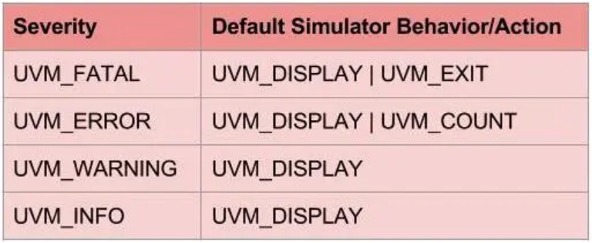
UVM Message facilities
Macros involved:
`uvm_info(string ID, string MSG, verbosity);
`uvm_error(string ID, string MSG);
`uvm_warning(string ID, string MSG);
`uvm_fatal(string ID, string MSG);

Slide 4
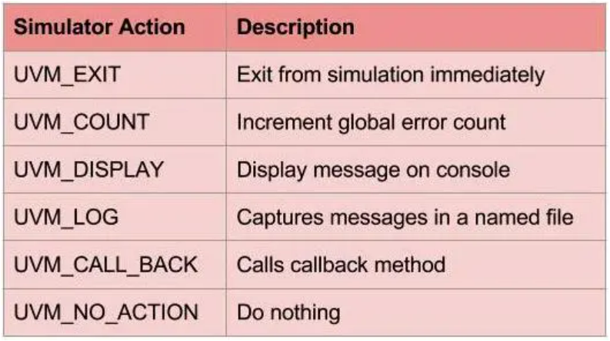
UVM Message facilities
Simulator Behavior/Actions Description

Slide 5
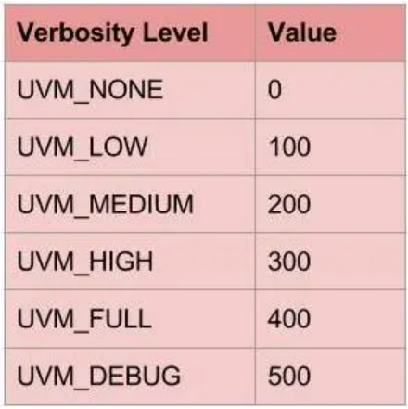
UVM Message facilities
Controlling Messages Verbosity:
In case of default Verbosity level i.e. UVM_MEDIUM, any messages with UVM_HIGH or above are filtered out.
A message with the Verbosity level UVM_NONE can not be disabled.
One can set the Verbosity level of a uvm_component individually or hierarchically using following commands:
drv.set_report_verbosity_level(UVM_HIGH);
env.set_report_verbosity_level_hier(UVM_FULL);
Notes:
`uvm_fatal, `uvm_error & `uvm_warning can not be filtered out via Verbosity level.

Slide 6
UVM Message facilities
UVM_NO_ACTION -- Do nothing UVM_DISPLAY -- Display report to standard output UVM_LOG -- Write to a file UVM_COUNT -- Count up to a max_quit_count value before exiting UVM_EXIT -- Terminates simulation immediately UVM_CALL_HOOK -- Callback the hook method .
Using these methods, user can set the verbosity levels and set actions. function void set_report_verbosity_level (int verbosity_level) function void set_report_severity_action (uvm_severity severity,uvm_action action) function void set_report_id_action (string id,uvm_action action) function void set_report_severity_id_action (uvm_severity severity,string id,uvm_action action)
Notes:
Following are the actions defined: UVM_NO_ACTION -- Do nothing UVM_DISPLAY -- Display report to standard output UVM_LOG -- Write to a file UVM_COUNT -- Count up to a max_quit_count value before exiting UVM_EXIT -- Terminates simulation immediately UVM_CALL_HOOK -- Callback the hook method .
Using these methods, user can set the verbosity levels and set actions. function void set_report_verbosity_level (int verbosity_level) function void set_report_severity_action (uvm_severity severity,uvm_action action) function void set_report_id_action (string id,uvm_action action) function void set_report_severity_id_action (uvm_severity severity,string id,uvm_action action)

Slide 7
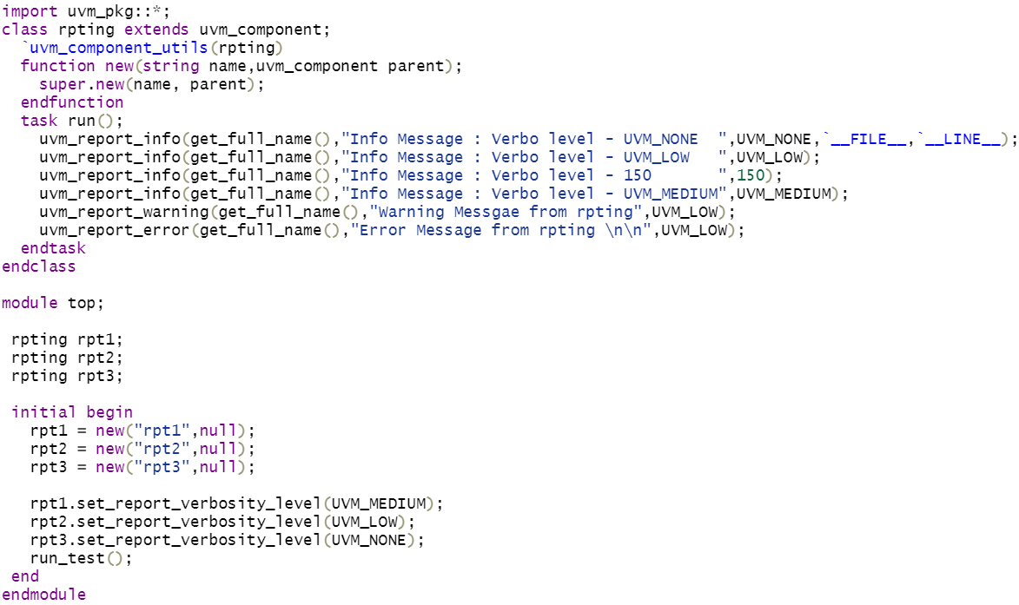
UVM Message facilities
Notes:
Following are the actions defined: UVM_NO_ACTION -- Do nothing UVM_DISPLAY -- Display report to standard output UVM_LOG -- Write to a file UVM_COUNT -- Count up to a max_quit_count value before exiting UVM_EXIT -- Terminates simulation immediately UVM_CALL_HOOK -- Callback the hook method .
Using these methods, user can set the verbosity levels and set actions. function void set_report_verbosity_level (int verbosity_level) function void set_report_severity_action (uvm_severity severity,uvm_action action) function void set_report_id_action (string id,uvm_action action) function void set_report_severity_id_action (uvm_severity severity,string id,uvm_action action)

Slide 8
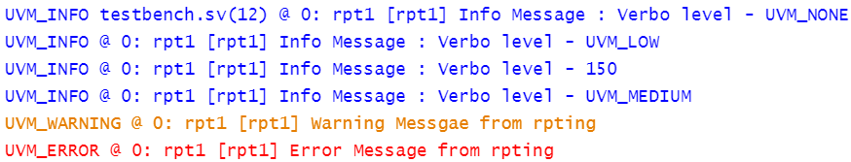
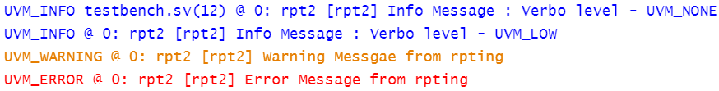
UVM Message facilities
Notes:
Following are the actions defined: UVM_NO_ACTION -- Do nothing UVM_DISPLAY -- Display report to standard output UVM_LOG -- Write to a file UVM_COUNT -- Count up to a max_quit_count value before exiting UVM_EXIT -- Terminates simulation immediately UVM_CALL_HOOK -- Callback the hook method .
Using these methods, user can set the verbosity levels and set actions. function void set_report_verbosity_level (int verbosity_level) function void set_report_severity_action (uvm_severity severity,uvm_action action) function void set_report_id_action (string id,uvm_action action) function void set_report_severity_id_action (uvm_severity severity,string id,uvm_action action)

Slide 9
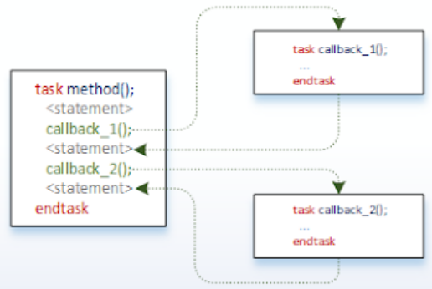
UVM Callback
Callbacks are empty methods with a call to them.
They are hooks to execute code that gets defined later.
Can be implemented in an object or component
UVM provides set of classes, methods and macros to implement callbacks.
Notes:
uvm callback might be used for simple notification, two-way communication, or to distribute work in a process.
Some requirements are often unpredictable when the transactor is first written. So a transactor should provide some kind of hooks for executing the code which is defined afterwards. In uvm, these hooks are created using callback methods.
For instance, a driver is developed and an empty method is called before driving the transaction to the DUT. Initially this empty method does nothing. As the implementation goes, user may realize that he needs to print the state of the transaction or to delay the transaction driving to DUT or inject an error into transaction. Callback mechanism allows executing the user defined code in place of the empty callback method.
Other example of callback usage is in monitor. Callbacks can be used in a monitor for collecting coverage information or for hooking up to scoreboard to pass transactions for self checking. With this, user is able to control the behavior of the transactor in verification environment and individual testcases without doing any modifications to the transactor itself.

Slide 10
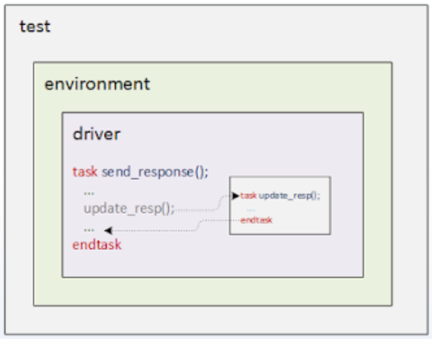
Callback example
Notes:
This example shows a simple driver, environment and test.
The driver has a drive() task that receives the seq_item and drives to the DUT. With the help of a callback, pre_drive() and post_drive() callbacks get added.

Slide 11
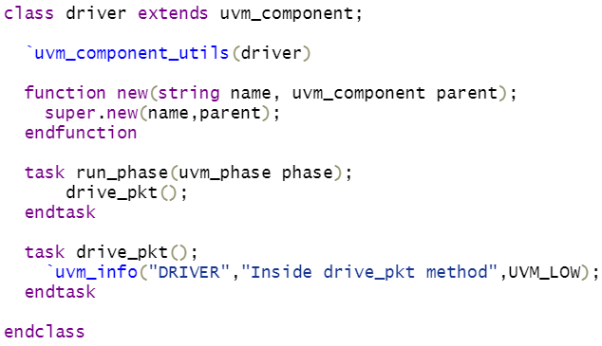
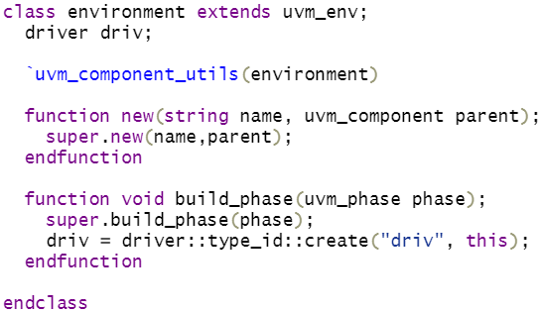
Example: Driver without callback

Slide 12
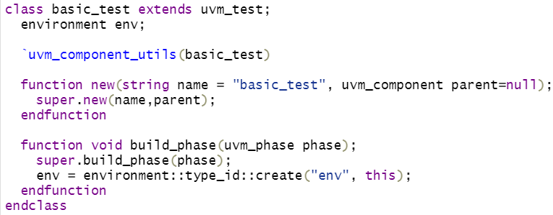
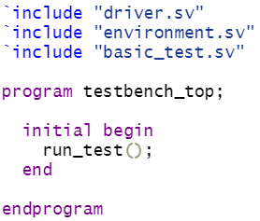
Example: Driver without callback

Slide 13
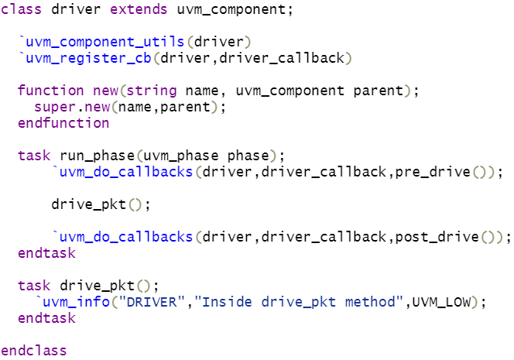
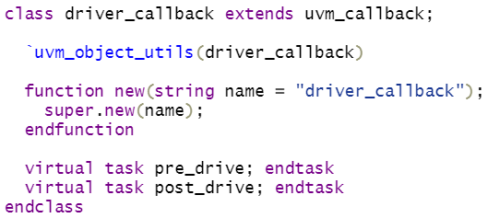
Example: Adding callback support
Notes:
For user-defined callbacks,
user has to write a user-defined callback class that extends the uvm_callback class.
define callback methods in user-defined callback class as virtual.
To use callbacks, the callback class has to be registered (`uvm_register_cb) with the object/component where callbacks are going to be used.
For user-defined callbacks,
user has to write a user-defined callback class that extends the uvm_callback class.
define callback methods in user-defined callback class as virtual.
To call the callback methods, place the callback hook in user-defined callback class (pre_drive() and post_drive())

Slide 14
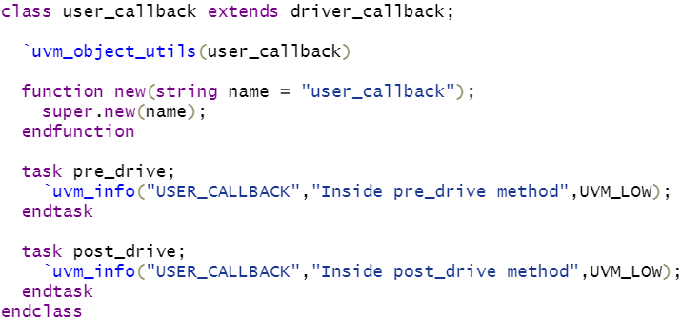
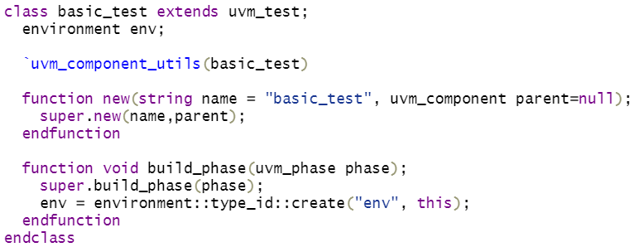
Example: Adding callback support

Slide 15
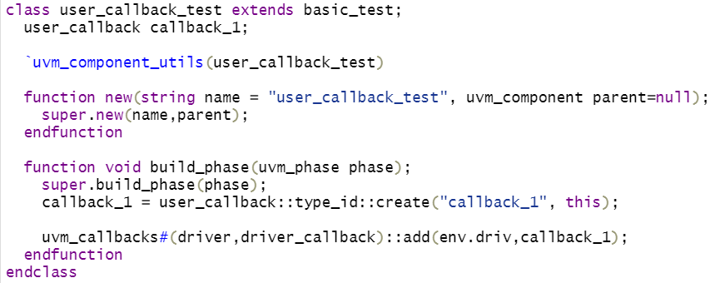

Example: Adding callback support
Notes:
Adding logic into callback methods:
Extend the user-defined callback class and write one more callback class callback_1
Implement methods with logic in it
In order to execute the callback method, register the callback object to the driver using the ‘add’ method

Slide 16
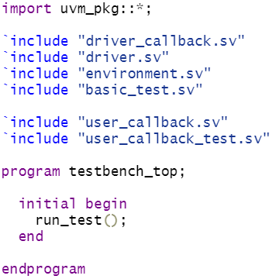
Example: Adding callback support
Notes:
user_callback_test is the test with callbacks added, and basic_test is without callbacks.
The second simulator output is with callback (callback_test).
The result shows that displays added in the callback methods are getting printed in callback_test.
The addition of logic to the callback methods will give more control on stimulus driving.

